Slide 1

nova.
Presented by Yusra Ashar

Slide 2
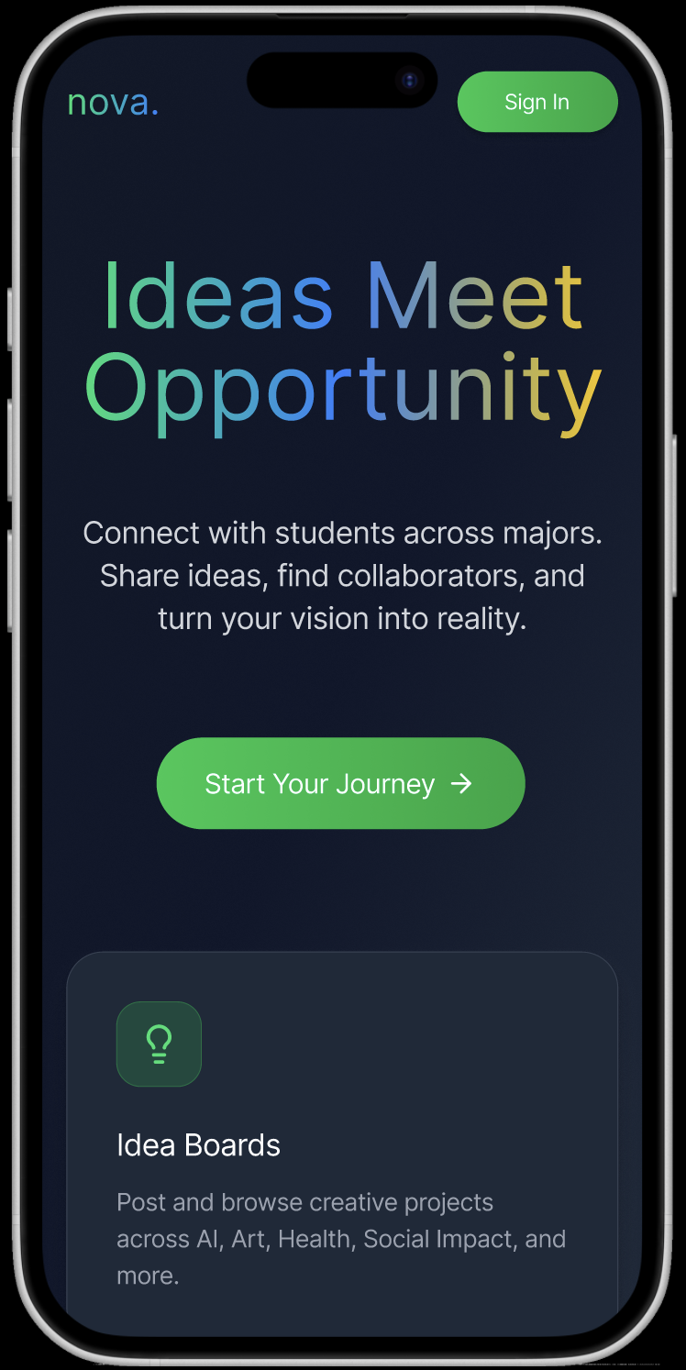
01
App Concept & Purpose

Slide 3
What is nova.
Nova is a student-centered productivity and social application designed to support academic organization and peer engagement in one unified platform. Many students rely on multiple tools to manage tasks, deadlines, and communication, which often leads to distraction and stress.
Nova addresses this issue by providing a clean, focused interface where users can manage their responsibilities while remaining socially connected. The primary goal of Nova is to improve productivity, reduce overwhelm, and create a more balanced student experience.

Slide 4
02
Resources

Slide 5
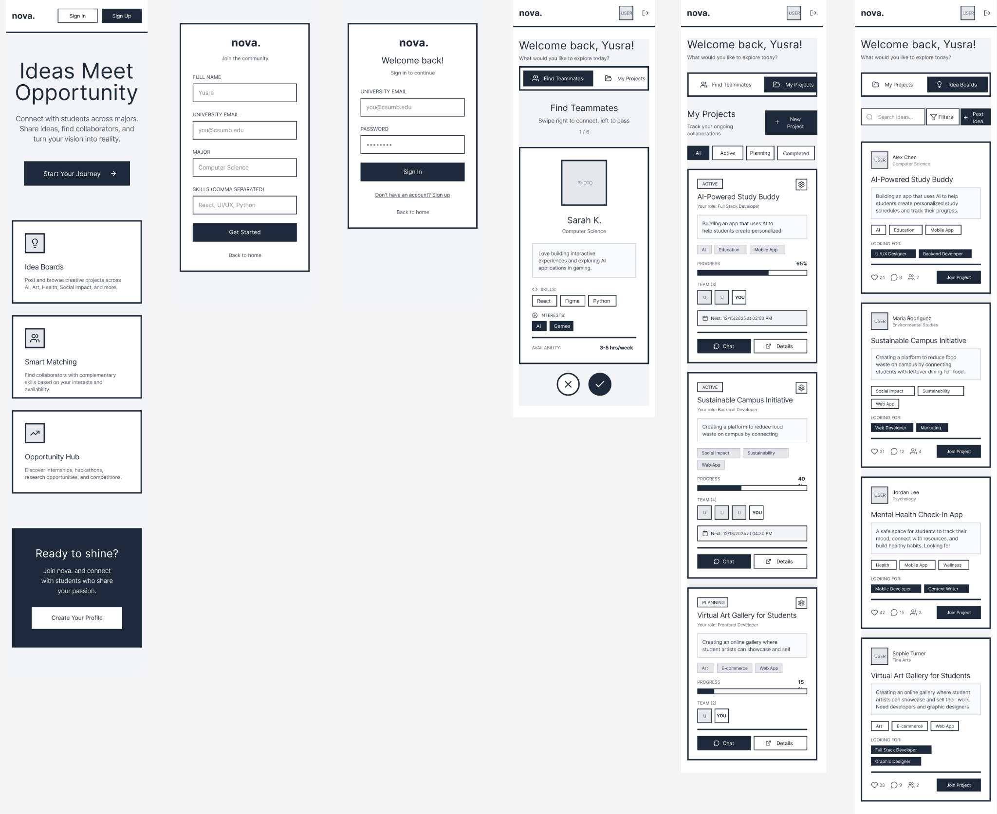
Lo-Fi Wireframes

Slide 6
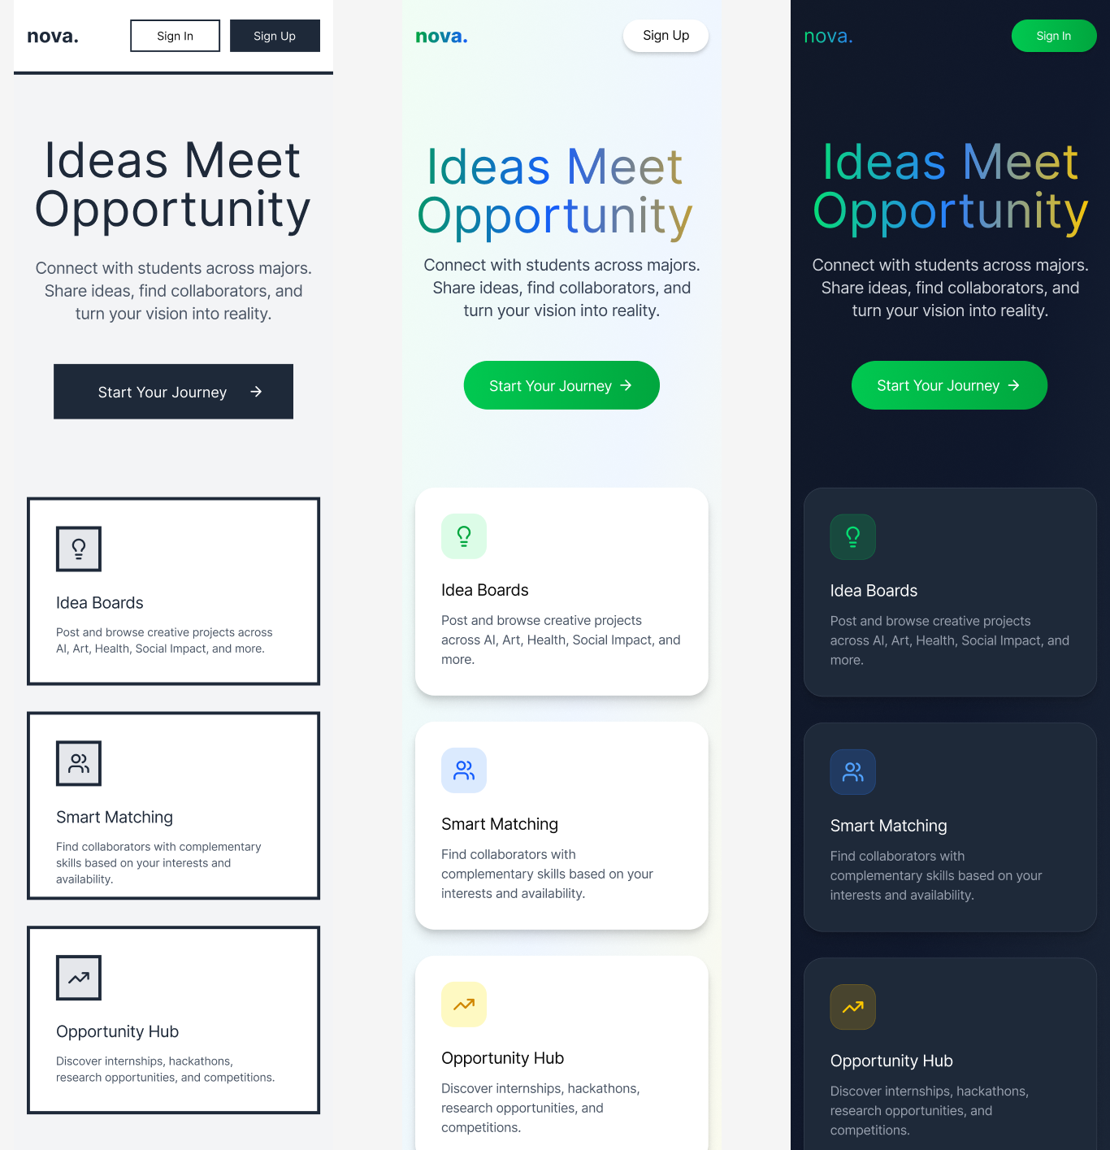
Iterations

Slide 7
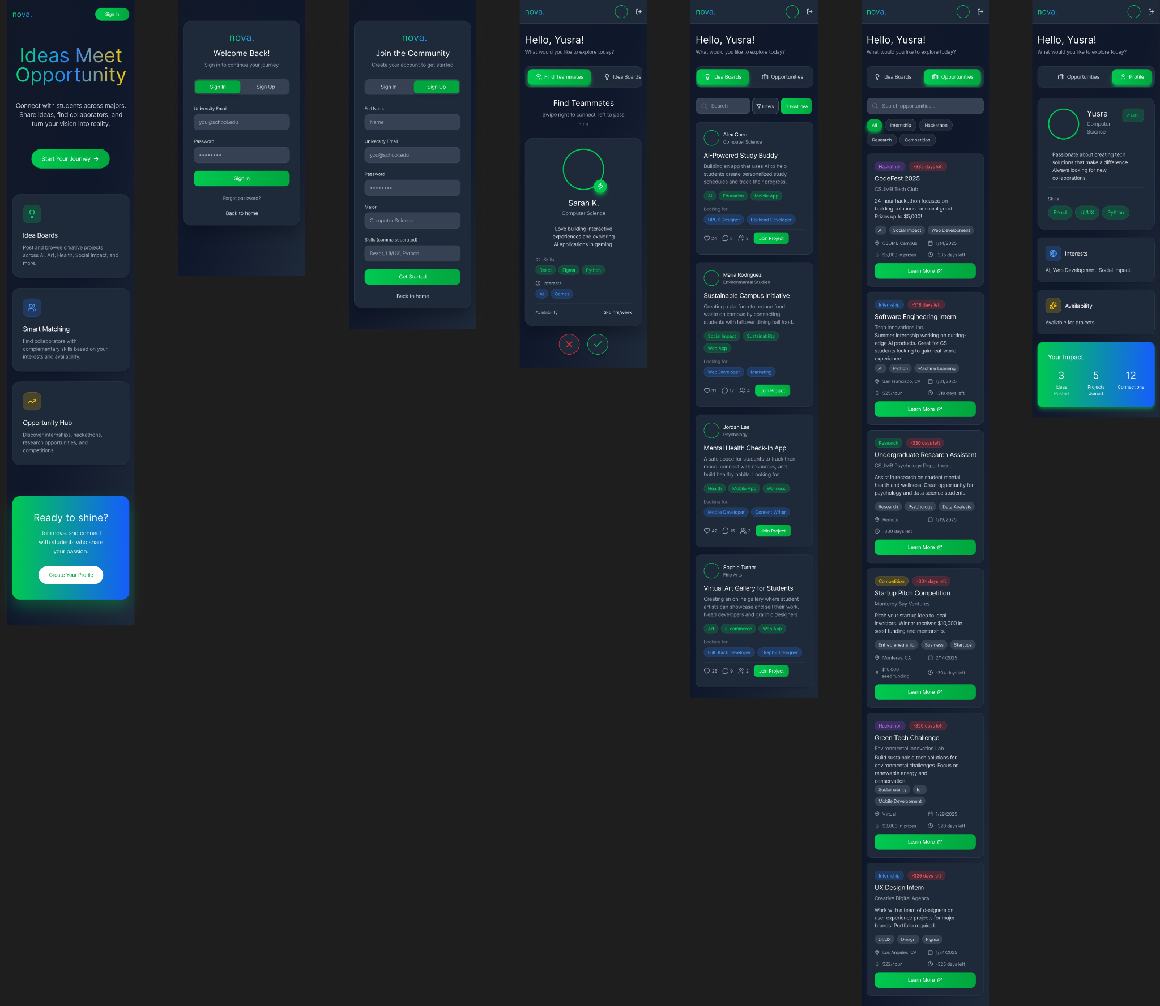
Hi-Fi Interface Designs

Slide 8
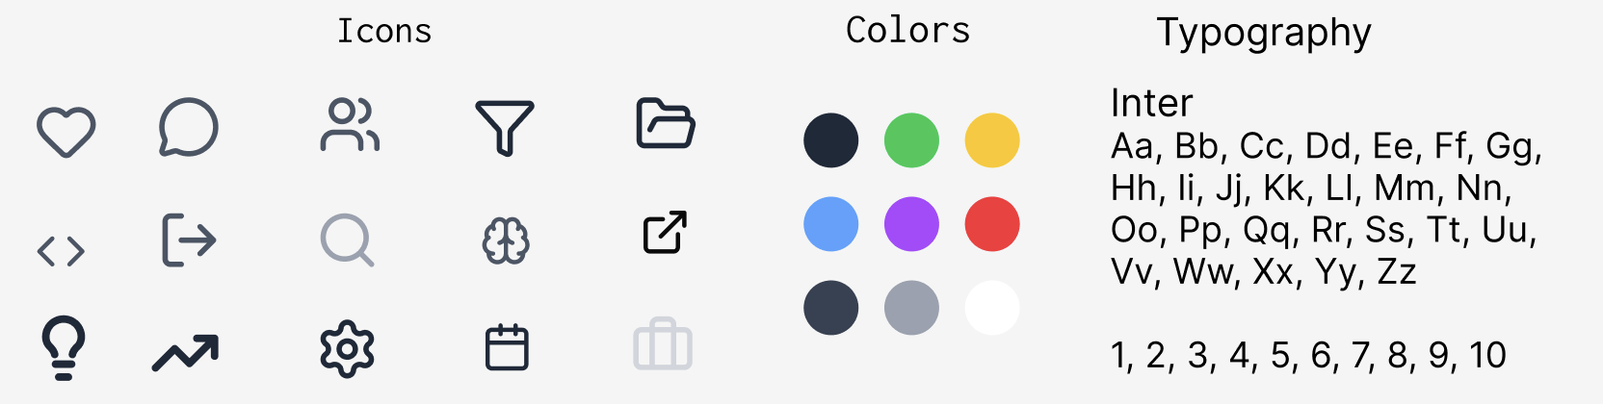
Icons, Color Palette, Typography

Slide 9
Link to Prototype
https://www.figma.com/design/oLzlpwekndQWirkurYmLi5/Nova?node-id=0-1&t=51sLK97hwIizsaSm-1

Slide 10
Thanks!
Do you have any questions?
yusraashar14@gmail.com
+1 (323 5466675

